Slide 1
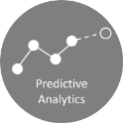

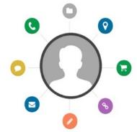
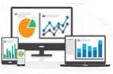
Success Story – 01
One line summary of project
Objectives
Outcome
Client’s overall business objectives
A
A
Increased by X%
A, for example:
A
A
A
Approach
How did you work on building the solution – mention technologies used, different ML algorithms used, features engineered etc.
A
A
A
A
Data Sources
Data universe integration
Customer 360
Analytics
Sales
Service
BI & visualization
PSF Data
Other Data
Analytics backbone
Analytics insights

Slide 2
Success Story – 01
Customer 360 and data analytics for a global automobile manufacturer
Objectives
Outcome
Client’s data had many inconsistencies, inaccuracies and duplicate entries; unusable for data analytics
Create a customer 360 view of unique customers, from multiple data sources, viz., sales enquiry, sales, after-sales, post-service feedback, value added services and old vehicle buy-back
Develop data driven customer analytics use cases
Increased response rate on targeted marketing campaigns for multiple products by up to 48%
Identified drivers behind customer churn from client’s value-chain, for example:
Vehicle model
Lifetime service attributes
Post-service feedback
Approach
Analyzed customer data and fixed inconsistencies viz., incorrect, missing values, wrong customer tagging, duplicate entries etc.
Assigned a unique identifier code to all records of the same customer after consolidating customer data from various data sources:
Data exploration: Filled missing values and explored data distribution
Deduplication rules on data: Identified ‘KEY’ customer identifiers common across data records
EDA: Identified all available data fields and their fill rates
Customer view development: Finalized KPIs for customer 360
Developed data driven use cases from customer 360 database
Customer loyalty segments based on historical transactions
Churn prediction, customer retention and targeted marketing
Data Sources
Data universe integration
Customer 360
Analytics
Sales
Service
BI & visualization
PSF Data
Other Data
Analytics backbone
Analytics insights

